Slide 1
Detecting Click Fraud in Mobile Advertising
Predictive Analytics : Spring 2015 Final Project
Arisha & Dimple

Slide 2




Introduction
Click Fraud – deliberate clicking on advertisements with no real interest on the product or service offered.
Fraud Detection in Mobile Advertising (FDMA) Competition on real-world fraud data from BuzzCity Ltd.
Identify fraudulent publishers who generate illegitimate clicks and distinguish them from normal publishers.
Advertiser
Ad Network/Advertising Commissioner
Content Publisher
Plans budget
Provides commissioner with ads
Agrees on commission for every customer action
Acts as a broker between advertisers and content publishers
Displays ads on their sites
Gets commission based on traffic it drives to advertisers
Click Fraud ??

Slide 3
BuzzCity Data Description
Publisher
Database
Publisher Database
Records the publishers profile
‘Status’ label:
Fraud: Publishers who are deemed as fraudulent with clear proof
OK: Publishers who have healthy traffic
Click Database
Captures the click traffic associated with various publishers over a 3 day period
Click
Database
 |  |  | No. of Publishers
Data Set | Time Period | No. of Clicks | Fraud | OK | Total
Train | 9-11 Feb 2012 | 3,173,834 | 72 (2.34%) | 3,009 (97.66%) | 3,081
Validation | 23-25 Feb 2012 | 2,689,005 | 85 (2.77%) | 2,979 (97.23%) | 3,064
Test | 8-10 Mar 2012 | 2,598,815 | 82 (2.73%) | 2,918 (97.27%) | 3,000

Slide 4
Preprocessing and Feature Extraction
Click Behavior
Features
Statistical features based on average and standard deviation.
Click Duplication
Features
Features capturing temporal aspects of clicks per publisher.
Clicks occurring in shorter time intervals (one minute clicks) tend to be fraudulent clicks.
High-Risk Click
Features
Percentages of clicks originating from countries like India, Indonesia, Singapore etc.
Fraudulent clicks tend to come from some countries more than others.
Total Clicks, Distinct IP address, Distinct URL, Night/morning/afternoon/evening clicks, Mobile device used.

Slide 5
Anomaly Detection – Detecting Click Fraud
Objective: The goal is to develop machine learning methods capable of building effective predictive models to detect fraudulent publishers.
Supervised anomaly detection (Classification based techniques):
Rule Based techniques (with Decision Trees)
Model based techniques
Naïve Bayes (Bayesian networks)
Neural Networks
Ensemble Methods:
Generalized Boosted Regression Model (GBM) using 5000 decision trees
Random Forests (Ensemble of decision trees)
Multilayer Perceptron (Ensemble of feed forward neural network)
Semi-Supervised anomaly detection:
One Class SVM
Notes:
Implements a binary classifier where the training data consists of examples of only one class (normal data).
High False Alarm Rate (or FPR) – previously unseen (yet legitimate) data records being recognized as anomalies.

Slide 6
Evaluation Metrics
Algorithms Tested | Precision (%) | Recall (%) | F Beta Score (%) | MCC (%) | Value of AUC
Random Forest | 66.667 | 26.829 | 30.471 | 41.352 | 63.226
Rule Based | 57.692 | 36.585 | 39.474 | 44.766 | 67.916
GBM | 64.103 | 30.488 | 34.060 | 43.195 | 65.004
One-class Support Vector Machine | 11.688 | 43.902 | 28.302 | 18.577 | 67.290
Naïve Bayes | 24.219 | 37.805 | 33.991 | 27.818 | 67.240
Neural Networks | 29.333 | 26.829 | 27.295 | 26.123 | 62.506
Ensemble Neural Network | 42.453 | 54.878 | 51.843 | 46.621 | 76.394
Notes:
- Lets just highlight the best result with a red border or something

Slide 7
Challenges
Class imbalance in data
Lack of examples
Best features require subject matter expert
Notes:
- The class imbalance of the normal and anomalous instances makes learning a classifier quite challenging.
Algorithms like rule based learning and neural networks do not have sufficient R examples for implementation and interpretation.
There is a lack of example for anomaly detection techniques, both on internet on google and in books, as the solutions related to fraud analytics are proprietary
- From a machine learning point-of-view, algorithms can provide high interpretability to fraud patterns. However, the key step prior to this is still to engineer the best features using domain knowledge and experimentation.

Slide 8
Thank You !!

Slide 9
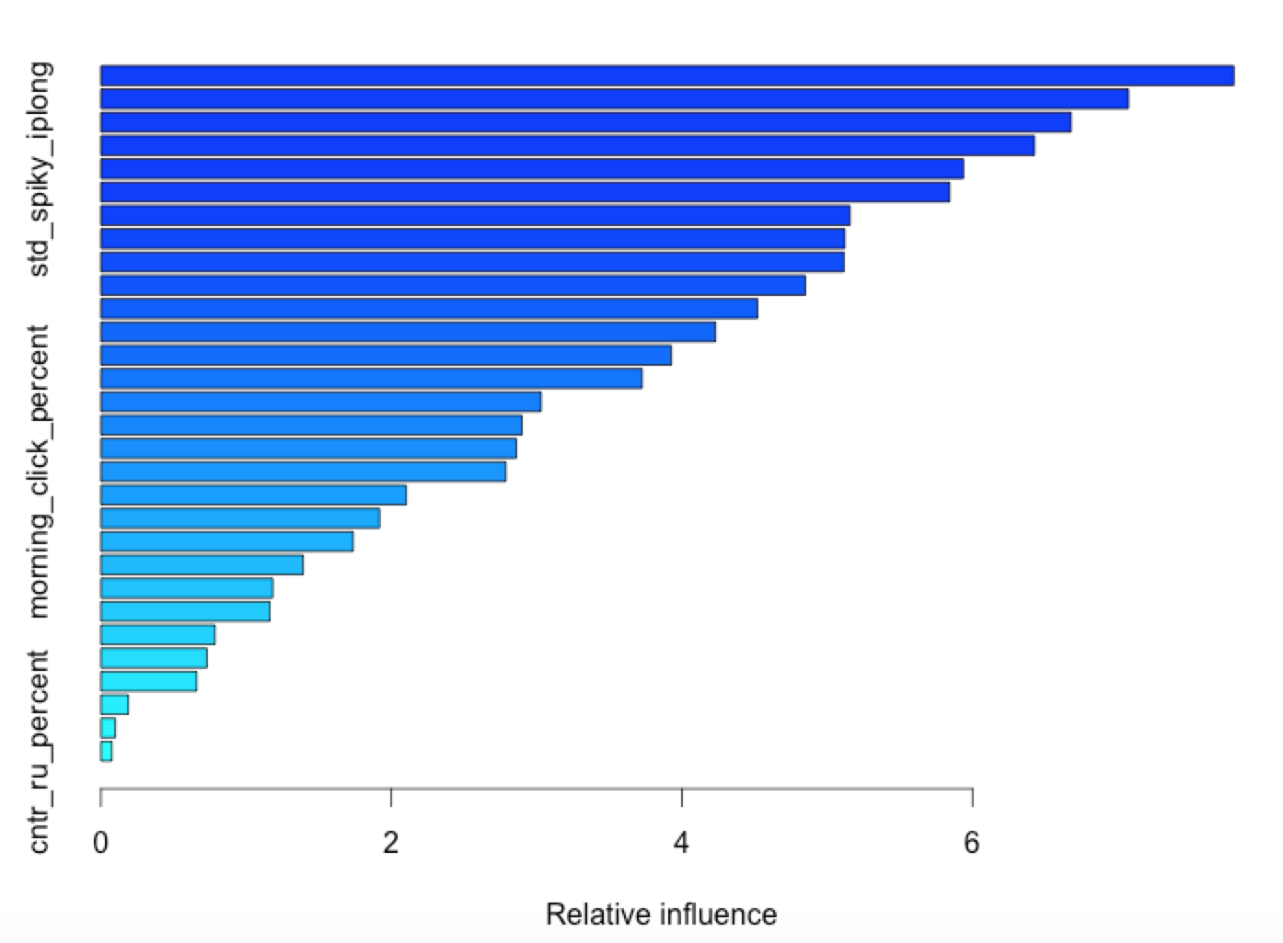
Appendix: Relative Influence

